Slide 1
Lesson 4 – Error propagation and handling

Slide 2
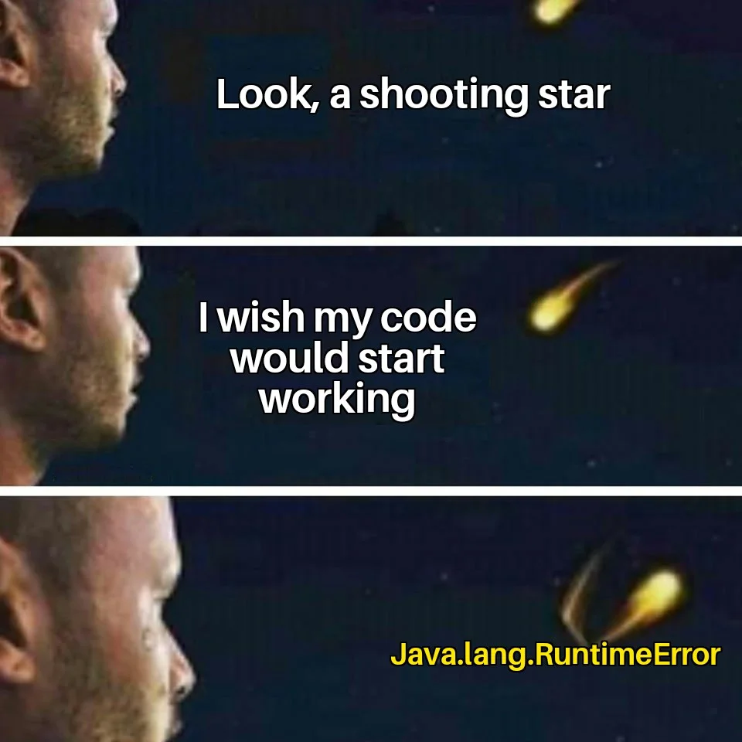

Lesson goals
Exceptions
Assertions

Slide 3
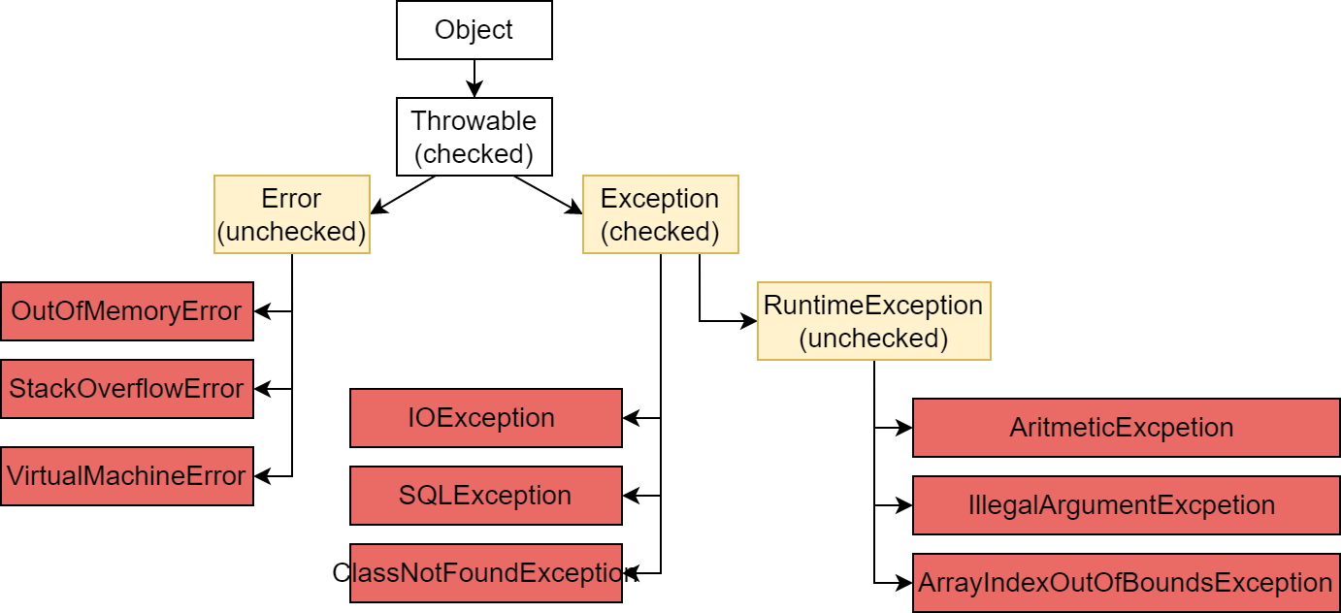
Exception hierarchy

Slide 4
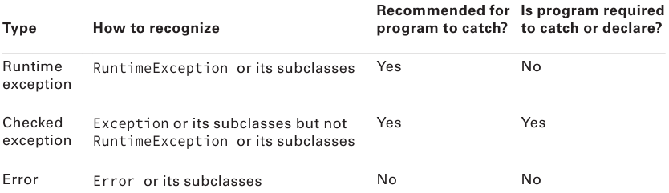
Exception types

Slide 5
Common exceptions
NullPointerException
ArrayIndexOutOfBoundsException
ArithmeticException
ClassCastException
IllegalArgumentException
…

Slide 6
Exception population
if(studentsCount <= 0) { throw new IllegalArgumentException(
“Student count should be a positive integer number”
);
}

Slide 7
Exception handling: Catch
LocalDate parse(String date) { DateParser parser = new DateParser("yyyy-MM-dd"); try { return parser.parse(date); } catch (DateParseException e) { log("Date parse failed", e); return null; } }

Slide 8
Exception handling: Declare
LocalDate parse(String date) throws DateParseException { DateParser parser = new DateParser("yyyy-MM-dd");
return parser.parse(date); }
Use throws only for checked exceptions

Slide 9
Unreachable exception handler
try { System.out.println("Hello"); } catch (ParseException e) { // Compile-time error
logger.error(”Parse exception caught", e); }

Slide 10
Exception catch blocks order
try { DateParser parser = new DateParser("yyyy-MM-dd"); LocalDate date = parser.parse(”2020-11-09"); System.out.println(date); } catch (DateParseException e) { log(“Date parse failed”, e); } catch (Exception e) { log(“Unexpected error”, e);
}

Slide 11
Using multi-catch
try { Path path = Paths.get("dolphinsBirthdays.txt"); String text = new String(Files.readAllBytes(path));
DateParser parser = new DateParser("yyyy-MM-dd");
LocalDate date = parser.parse(text); System.out.println(date); } catch (DateParseException e) {
throw new RuntimeException(e); // Code duplication } catch (IOException e) {
throw new RuntimeException(e); // Code duplication }

Slide 12
Using Multi-catch
try { Path path = Paths.get("dolphinsBorn.txt"); String text = new String(Files.readAllBytes(path));
DateParser parser = new DateParser("yyyy-MM-dd"); LocalDate date = parser.parse(text); System.out.println(date);
} catch (DateParseException | IOException e) { throw new RuntimeException(e); }

Slide 13
Issues?
try { mightThrow(); } catch(FileNotFoundException | IllegalStateException e) {
e = new RuntimeException(); } catch(InputMismatchException e | MissingResourceException e) {
} catch(FileNotFoundException | IOException e) { } catch(SQLException e){ } catch(FileNotFoundException | IllegalArgumentException e) {
} catch(Exception e) { } catch(IOException e) { }
private void mightThrow() throws DateParseException, IOException {…}

Slide 14
Issues!
try { mightThrow(); } catch(FileNotFoundException | IllegalStateException e) {
e = new RuntimeException(); } catch(InputMismatchException e | MissingResourceException e) {
} catch(FileNotFoundException | IOException e) { } catch(SQLException e){ } catch(FileNotFoundException | IllegalArgumentException e) {
} catch(Exception e) { } catch(IOException e) { }
private void mightThrow() throws DateParseException, IOException {…}
try { mightThrow(); } catch(FileNotFoundException | IllegalStateException e) {
e = new RuntimeException(); // in multicatch variable is effectively final
} catch(InputMismatchException e | MissingResourceException e) { // extra variable name
} catch(FileNotFoundException | IOException e) { // different hierarchy
} catch(SQLException e){ // cannot catch SQLException because nothing can potentially throw one } catch(FileNotFoundException | IllegalArgumentException e) { // cannot catch FileNotFoundException because was already caught on first catch } catch(Exception e) { // more general superclasses must be caught after their subclasses. } catch(IOException e) { // more general superclasses must be caught after their subclasses. }
private void mightThrow() throws DateParseException, IOException {…}

Slide 15
Custom exceptions
class WaterFillingException extends IOException { public WaterFillingException() { } WaterFillingException(String message) { super(message); } WaterFillingException(String message, Throwable cause) { super(message, cause); } }
class CapNotFoundException extends WaterFillingException { }
class BottleOverloadException extends WaterFillingException { }

Slide 16
Custom exceptions
class Bottle { private final int maxVolume; private int currentVolume;
void addWater(int volumeToAdd) { int targetVolume = currentVolume + volumeToAdd; if (targetVolume > maxVolume) { this.currentVolume = maxVolume; throw new BottleOverloadException("Bottle is running out of capacity!"); } this.currentVolume = targetVolume; System.out.printf("Added %d. Current value %d”, volumeToAdd, this.currentVolume); } }

Slide 17
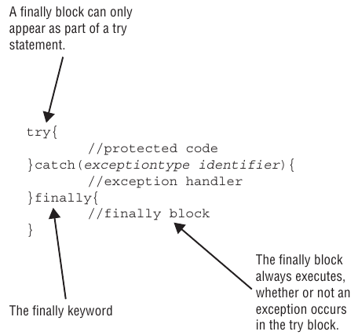
Try catch finally statement

Slide 18
Try catch finally statement
Open resource
Try to manipulate with resource
Catch any errors
Finally close resource

Slide 19
Resource management
class Bottle implements AutoCloseable { private final int maxVolume; private int currentVolume;
void addWater(int volumeToAdd) { int targetVolume = currentVolume + volumeToAdd; if (targetVolume > maxVolume) { this.currentVolume = maxVolume; throw new BottleOverloadException("Bottle is running out of capacity!"); } this.currentVolume = targetVolume; System.out.printf("Added %d. Current value %d”, volumeToAdd, this.currentVolume); }
… @Override public void close() { System.out.printf(”Bottle closed”); } }

Slide 20
Resource management: Old School
void oldSchool(String brand1, String brand2) { Bottle in = null; Bottle out = null; try { in = BottleFactory.newBottle(brand1) out = BottleFactory.newBottle(brand2);
out.addWater(in.getWater()); } finally { try { if (in != null) in.close(); } catch (IOException e) { log(e);
} try { if (out != null) out.close(); } catch (IOException e) { log(e);
} } }

Slide 21
Resource management: New School (ARM)
void newSchool(String brand1, String brand2) { try (
Bottle in = BottleFactory.newBottle(brand1); Bottle out = BottleFactory.newBottle(brand2)
) { out.addWater(in.getWater()); } }

Slide 22
Resource management
class Bottle implements AutoCloseable { private final int maxVolume; private int currentVolume;
void addWater(int volumeToAdd) { int targetVolume = currentVolume + volumeToAdd; if (targetVolume > maxVolume) { this.currentVolume = maxVolume; throw new BottleOverloadException("Bottle is running out of capacity!"); } this.currentVolume = targetVolume; System.out.printf("Added %d. Current value %d”, volumeToAdd, this.currentVolume); }
… @Override public void close() { System.out.printf(”Bottle closed”); } }

Slide 23
ARM: Suppressed Exceptions
class Bottle implements AutoCloseable { private final int maxVolume; private int currentVolume;
void addWater(int volumeToAdd) { int targetVolume = currentVolume + volumeToAdd; if (targetVolume > maxVolume) { this.currentVolume = maxVolume; throw new WaterFillingException("Bottle is running out of capacity!"); } this.currentVolume = targetVolume; System.out.printf("Added %d. Current value %d”, volumeToAdd, this.currentVolume); }
… @Override public void close() throws IOException { throw new CapNotFoundException("Bottle cannot be closed, no cap!"); } }

Slide 24
ARM: Suppressed Exceptions
Java treats the first exception as the primary one and tacks on any that come up while automatically closing
Suppressed exceptions apply only to exceptions thrown in the try clause

Slide 25
ARM: Suppressed Exceptions
try (Bottle bottle = new Bottle()){ bottle.addWater(1); bottle.addWater(1); bottle.addWater(1); bottle.addWater(1); } catch (IOException e) { log(”Water filling failed", e); }
Created bottle with max volume 3
Added 1. Current value 1
Added 1. Current value 2
Added 1. Current value 3
Exception in thread "main" org.geekhub.BottleOverloadException: Bottle is running out of capacity!
at Bottle.addWater(scratch_1.java:17)
at Main.main(scratch_1.java:36)
Suppressed: org.geekhub.CapNotFoundException: Bottle cannot be closed, no cap!
at Bottle.close(scratch_1.java:26)
at Main.main(scratch_1.java:37)

Slide 26
Default exception handler
Prints out exception description;
Prints the stack-trace;
Causes the program to terminate.

Slide 27
Stack trace
throw new CapNotFoundException();
Exception in thread "main" org.geekhub.Main$CapNotFoundException
at org.geekhub.Main.main(Main.java:10)

Slide 28
Stack trace
throw new CapNotFoundException("No caps left");
Exception in thread "main" org.geekhub.Main$CapNotFoundException: No caps left
at org.geekhub.Main.main(Main.java:10)

Slide 29
Stack trace
throw new CapNotFoundException("No caps left",
new RobberyException(”Joker has stolen all caps") // cause
);
Exception in thread "main" org.geekhub.Main$CapNotFoundException: No caps left
at org.geekhub.Main.main(Main.java:10)
Caused by: org.geekhub.Main$RobberyException: Joker has stolen all caps
... 1 more

Slide 30
Assertion
An assertion is a boolean expression that you place at a point in your code where you expect something to be true
An assertion allows for detecting defects in the code
The syntax for an assert statement has two forms:
assert boolean_expression; assert boolean_expression: "error_message";
Assertions are DISABLED by default.

Slide 31
Assertion
public static void main(String[] args) { int result = multiplyAll(0, 2, 3); assert result > 0 : "Result should be positive"; } private static int multiplyAll(int a, int b, int c) { return a * b * c; }
Exception in thread "main" java.lang.AssertionError: Result should be positive
at AssertionExample.main(AssertionExample.java:4)

Slide 32
Homework. Logger
Add a logging mechanism that will output application logs to the console.
- Logs can have type "WARNING", "INFO" and "ERROR".
- Logs have the name of the class in which the error occurred.
- Logs can have exception info.
- Logs in the console should look like:
"[{WARNING_LEVEL}] {CLASS_NAME}: {LOG_MESSAGE}"
- Logs with an error should look like:
"[{WARNING_LEVEL}] {CLASS_NAME}: {LOG_MESSAGE} \ n {STACK_TRACE}"
- User can see all application logs from console menu
Cover your code with INFO, WARNING, ERROR level logs.

Slide 33
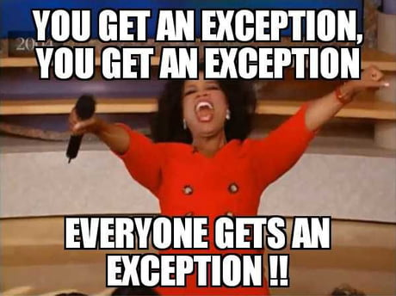
Homework. Exceptions
Add new LessonNotFound and ValidationException exceptions. (Maybe even more)
- When a user tries to get a lecture that does not exist, throw a LessonNotFoundException. This error must be caught, logged and processed.
- When a user tries to create a new lecture without specifying a lecture title or the teacher - throw a ValidationException.
- When a user tries to create a new resource with an invalid type, throw InvalidArgumentException.
All errors should be caught and displayed in the console using a logger.

Slide 34
Links
Java error model:
Baeldung
Exceptions (Oracle)
Books:
“Clean Code” by Robert Martin (up to 8)
“Java: The Complete Reference” by Herbert Schildt (chapter 10)

Slide 35
Thanks!
Any Questions?
Find us in Slack:
@Bohdan Cherniak
@Vlad Nikolenko
@Volodymyr Vedula

